Slide 1

Subscribe to DeepL Pro to edit this document.
Visit www.DeepL.com/pro for more information.

Slide 2
Mathematics through sound – the potential applications of audio-visual presentations in the study of functions
Szilvia Szakácsné Nagy
University of Debrecen
Doctoral School of Mathematics and Computational Sciences
Didactics (Methodology) programme, PhD candidate
László Rátz Travelling Conference – Békéscsaba, 2–5 July 2013

Slide 3
A brief summary of the content
Objective
Visible and audible properties of functions
The advantages of audio-visual representation in function theory

Slide 4
Acknowledgements to the two institutions that provided the research base
Kindergarten, Primary School, Special Vocational School and Methodological Institute for the Blind (2006–2009)
Széchenyi István Bilingual Vocational Secondary School of Economics (2012/13)

Slide 5
“The problems of learning and teaching are psychological problems…”
“Generalising empirical observations leads to the mathematical model…”
Skemp
Notes:
Skemp drew a clear distinction between physical observation and mathematical modelling, and clarified the question of which takes precedence. Let’s not make children memorise rules.

Slide 6
Objective
The ‘systems of rules’ describing processes in fields such as economics and engineering can be modelled using far more complex equations and, in most cases, cannot even be represented.
In many cases, it is essential to understand the relationship between reality and the presentation ofa function ona symbolic plane (mathematical symbols) and to develop the ability to apply this understanding. Precise implementation falls to higher education, but what should we focus on during school education?
Without claiming to be exhaustive, I would like to share and open up for discussion a few methodological observations that have emerged during my research.
What is the purpose of graphing and characterising functions in terms of the development of the concept of a function?
How can the use of audio-visual representations of functions aid progress?

Slide 7
Levels of function teaching (Peller 1998)
Level 4: Mathematical analysis
Level 3: Elementary study of functions
Level 2: Mathematical description of motion and quantitative relationships
Level 1: Direct investigation of motion and quantitative relationships
Notes:
Movement is a continuous process; it creates continuous changes—patterns of motion—in the optical structure visible to the eye, allowing us to perceive the actual configuration of our surroundings. Through movement, and based on the visual information we receive, we are able to perceive our own position, our own movement, and the configuration of our surroundings.

Slide 8
The role of the graph in establishing connections
Most of the real functions featured in textbooks can also be presented using graphs (depictions centred around the origin are particularly popular).
Growth relationships observable on the iconic communication plane, multi-perspective observations that can be carried out independently of one another (does the graph intersect the X-axis, does the origin lie on the curve, does the function value reach a specified limit within the defined range of interpretation, etc.) aim to establish a connection between processes observable in reality and the mathematical structure describing those processes.

Slide 9
The role of the graph as a ‘bridge’ between the concrete and symbolic planes of communication
All three planes of communication—concrete, iconic and symbolic—which are well-known in the field of mathematics education and frequently used by colleagues, are employed in the topic of functions.
Whilst we imbue the symbol with meaning (we must agree on what we mean by x), the visual and auditory presentation on the iconic plane is capable of preserving numerous properties characteristic of the process.
If we succeed in ‘convincing’ the student that the graph is a representation of the model defined by the combination of the mapping rule, domain and range specified on the symbolic level, then the function graph truly fulfils its intended role.
Unfortunately, among some students:
the graph somehow ‘takes over’ the role of the function along the way;
the set of ordered pairs presented in the Cartesian coordinate system takes on some sort of shape (e.g. resembling the letter W or a bowl, etc.).
Notes:
Objective level: learning takes place through specific practical activities, actions and manipulations aimed at achieving a goal.
Visual level: knowledge acquisition takes place with the help of visual images or imagined situations.
Symbolic level: Knowledge acquisition takes place with the help of mathematical symbols and language.
Images contain a certain degree of structural or visual similarity to the thing depicted. Symbols do not have this role; symbols have meaning.
The three modes of representation play a role in every phase of the educational process

Slide 10
Tools
For graphing functions, the MathTrax software, developed by NASA (2006) and available for free download and use, can be downloaded from the following website:
http://prime.jsc.nasa.gov/mathtrax/download.htm
During the experiment, the pupils learnt to use the software independently over the course of four lessons in the computer room, with the help of thefollowing videos available on YouTube (which I created and which are also freely available):
Audible Maths – Function Transformation: Linear Function
Audible Maths – Function Transformation: Parabola
Audible Maths – Voicing time series: climate
If required, a set of exercises tailored to individual needs can be requested at the following address:
szakacsne.nagy.szilvia@gk.szie.hu or
szilvi.nagy.sz@citromail.hu
Notes:
The ViewPlus® Technologies story begins with Dr John A. Gardner, a world-renowned solid-state physicist who lost his sight at the age of 48 due to complications from eye surgery. Gardner faced enormous barriers when he returned to his role as a physics professor and researcher at Oregon State University.
Gardner found that certain information required to communicate in the field of solid-state physics was difficult, if not impossible, to access, even with assistance from sighted helpers. In particular, he found there were very few tools available for blind people to convert visually-oriented information, such as diagrams and structured mathematics, into a medium that could be fully understood through touch and sound.
Drawing on his extensive expertise in securing grant funding at Oregon State University, Gardner dedicated himself to researching and developing innovative technologies that could minimise the communication gap between himself and his sighted colleagues. Under the umbrella of the acclaimed Science Access Project (SAP) at Oregon State University, Gardner and his team initiated the first work on Tiger® embossing technology, the Audio Graphing Calculator (AGC), as well as other important developments.
As SAP received international acclaim for its work, Gardner began to seek commercial applications for their inventions. In 1996 he founded ViewPlus® Technologies to bring SAP innovations into the commercial realm and further advance his mission to make science and maths more accessible to people with sensory and learning disabilities.
ViewPlus is now recognised worldwide as a leading innovator in assistive technology. The company’s research and development work is driven largely by sales revenue from its popular range of Tiger® Braille printers. Generous Small Business Innovative Research (SBIR) grant funding is also provided through the National Science Foundation (NSF) and the National Institutes of Health (NIH), forming the basis for innovative new products such as the IVEO® Tactile-Audio system.

Slide 11
Visible and audible function properties

Slide 12
Audiovisual representation of function properties:
Positive and negative function values, zero point
The process of increasing
The process of decreasing
Local extrema
Functions bounded from below and above
Even (and odd) functions
Periodic functions
Points of discontinuity

Slide 13
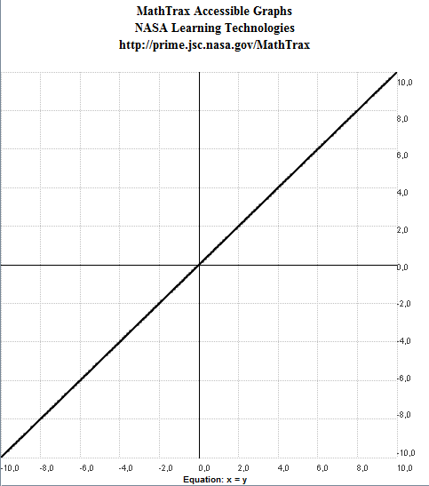
Positive and negative function values, zeroes
Following the ‘negative values’ in the sound sample, accompanied by a rising, hissing sound (white noise), a whistle indicates the zero point, after which clear rising tones signal the positive values.

Slide 14
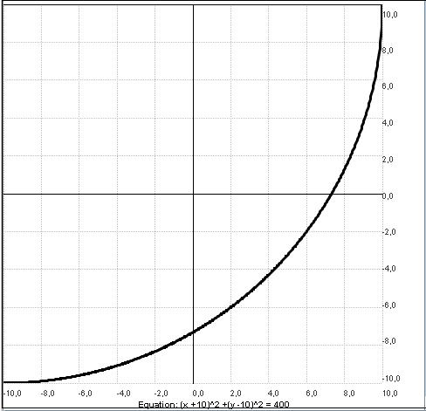
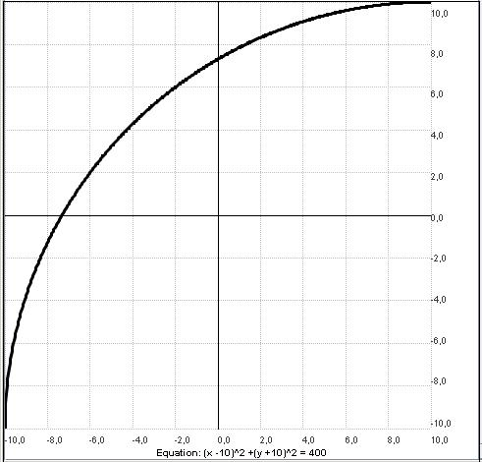
Increasing function
Convexly
Convexly
Notes:
Convex increasing = accelerating
Concave increasing = decelerating

Slide 15
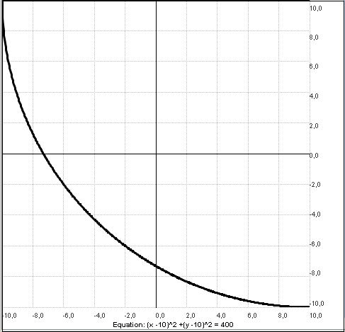
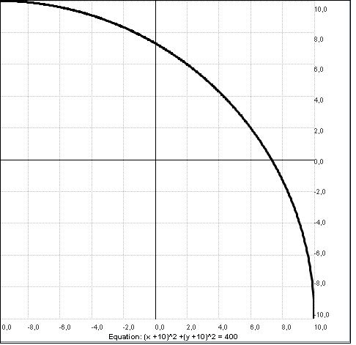
Decreasing function
Convexly
Convexly
Notes:
Convex decreasing = decreasing at a slowing rate
Concave decreasing = decreasing at an accelerating rate

Slide 16
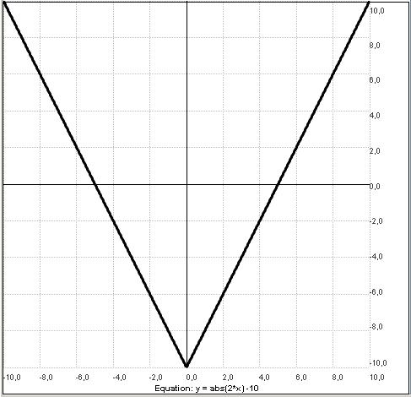
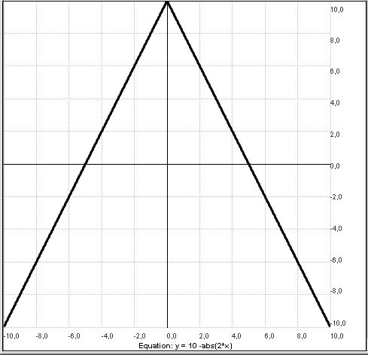
Local extreme value point
Local minimum
Local maximum point

Slide 17
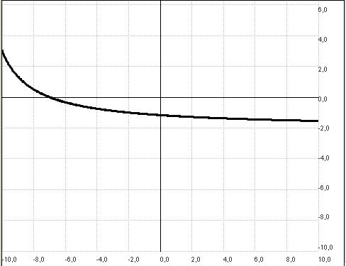
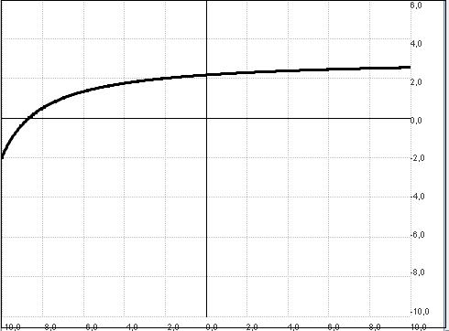
Bounded functions
Limited from below
Bounded from above

Slide 18
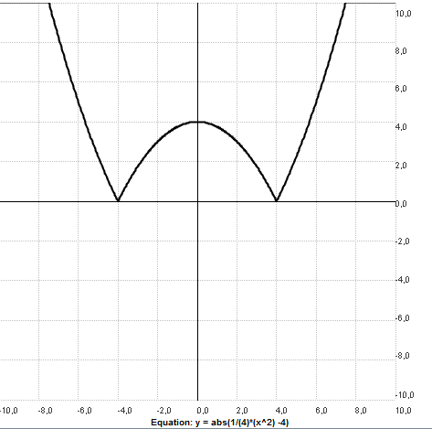
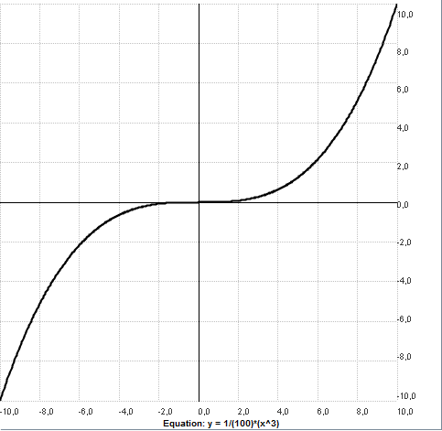
Even and odd functions
Even
Odd

Slide 19
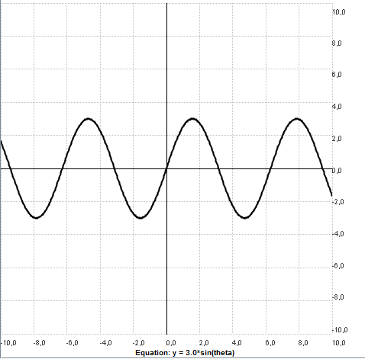
Periodic functions

Slide 20
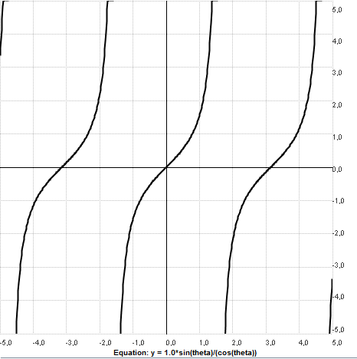
Breaking points

Slide 21
The benefits of audiovisual representation in calculus

Slide 22
We assume a direct connection between the senses, without an intermediary mapping system. Secondary source (Kovács 2010).

Slide 23
The Theory of Auditory Representation
Auditory representation: the non-verbal vocalisation of information (analogue and symbolic mapping).
Its aim is to open up the dimension of informative background sounds, statistical, interface and status messages (earcons, i.e. the auditory equivalent of icons) and warnings (auditory warnings) for everyday life.
Secondary source: Kovács (2010)

Slide 24
Audio-visual representation in calculus using MathTrax (1)
Due to the intuitive nature of sound processing, it can be incorporated into the learning process with virtually no practice required (though not for everyone!).
Sound samples are easy to analyse thanks to the sensitivity of the ear and its effective pattern recognition ability in accordance with Gestalt principles.
Supplementing visual representations with audio information drastically increases the temporal resolution of information acquisition, helping students to concentrate and pay attention.
It can help students identify specific features of a graph (directing attention) even in diagrams that may be complex for them, if highlighting parts proves difficult.
It is possible to gradually increase the complexity of the graph (by adjusting settings for negative values, axis intersections, and audible signals when the graph ‘crosses’ the origin).

Slide 25
Audio-visual representation in calculus using MathTrax (2)
The content of the visual and auditory representations is identical, as they are based on the same mapping rule; the two modalities reinforce each other (redundancy has a positive effect on the information acquisition process).
It is possible to observe the movement of a vertical line or a ‘red dot’ during playback, which helps guide the ‘reading’ of the still image. It forms a bridge between the construction and interpretation of the graph, helping to form a mental map of the graph.
The audio draws attention to the relationships between ordered pairs of elements (reinforcing the dynamic perspective of the function: is a larger x value assigned a larger, equal or possibly smaller value? An important foundation for establishing the concept of the derivative).
By pausing the presentation at any point, the data for the ordered pairs can be read off separately (supporting an intuitive set-theoretic approach).

Slide 26
Audio-visual aids in mathematics teaching
NASA MathTrax Homepage
http://prime.jsc.nasa.gov/mathtrax/
Accessible Graphing Calculator (AGC) www.viewplus.com
Audible Maths website http://gfk.tsf.hu/hallhato-matematika/
Notes:
The ViewPlus® Technologies story begins with Dr John A. Gardner, a world-renowned solid-state physicist who lost his sight at the age of 48 due to complications from eye surgery. Gardner faced enormous barriers when he returned to his role as a physics professor and researcher at Oregon State University.
Gardner found that certain information required to communicate in the field of solid-state physics was difficult, if not impossible, to access, even with assistance from sighted helpers. In particular, he found there were very few tools available for blind people to convert visually-oriented information, such as diagrams and structured mathematics, into a medium that could be fully understood through touch and sound.
Drawing on his extensive expertise in securing grant funding at Oregon State University, Gardner dedicated himself to researching and developing innovative technologies that could minimise the communication gap between himself and his sighted colleagues. Under the umbrella of the acclaimed Science Access Project (SAP) at Oregon State University, Gardner and his team initiated the first work on Tiger® embossing technology, the Audio Graphing Calculator (AGC), as well as other important developments.
As SAP received international acclaim for its work, Gardner began to seek commercial applications for their inventions. In 1996 he founded ViewPlus® Technologies to bring SAP innovations into the commercial realm and further advance his mission to make science and maths more accessible to people with sensory and learning disabilities.
ViewPlus is now recognised worldwide as a leading innovator in assistive technology. The company’s research and development work is driven largely by sales revenue from its popular range of Tiger® Braille printers. Generous Small Business Innovative Research (SBIR) grant funding is also provided through the National Science Foundation (NSF) and the National Institutes of Health (NIH), forming the basis for innovative new products such as the IVEO® Tactile-Audio system.

Slide 27
References
Csaba Pléh (1998). An Introduction to Epistemology. Typotex Publishing, Budapest.
Ulric Neisser (1984). Cognition and Reality. Gondolat Publishing House, Budapest.
Gabriella Dohány (2010). Possibilities for Interpreting Musical Literacy. Magyar Pedagógia, Vol. 110, No. 3, pp. 185–210.
Edited by Valéria Csépe, Miklós Győri and Anett Ragó (2007). General Psychology 1 – Perception and Attention. Osiris Publishing, Budapest.
András Ambrus (2003). Classification of tasks based on their function in the educational process. http://xml.inf.elte.hu/~mathdid/
József Peller (2003). On the process of acquiring mathematical knowledge. Eötvös Publishing House – Budapest.
Balázs Kovács (2010). Dialogue of the Senses – The Aesthetics of Interactive Sonification. Budapest, ELTE, PhD thesis.
R. Skemp: The Psychology of Mathematical Learning, Budapest, 1975.
http://www.viewplus.eu
Éva Vásárhelyi (2003). Concept Formation and Representations. http://xml.inf.elte.hu/~mathdid/

